Slide 1

SAP BTP ABAP on Cloud / RAP Training
DAY-14
Anubhav Oberoy
www.AnubhavTrainings.com
Follow excellence with sheer passion

Slide 2


DISCLAIMER
The training content and delivery of this presentation is confidential, and cannot be recorded, or copied and distributed to any third party, without the written consent of Anubhav Trainings

Slide 3

01
Create OVP
02
Custom Entity
03
Access External API
04
Consume API
Notes:
https://pixabay.com/photos/san-francisco-transamerica-pyramid-1633203/

Slide 4
Booking Consumption Analytics View
Booking Analytics CDS entity
Travel Analytics CDS entity
Carrier
Connection
/dmo/travel
/dmo/customer
/dmo/agency
Bookings

Slide 5
OVP – Overview pages
The Overview Page (OVP) in SAP is a data-driven app that provides users with a single page of information based on their role or domain. It helps users focus on important tasks by allowing them to quickly view, filter, and react to information.
Here are some things to know about the OVP:
Structure
The OVP has a header area and a content area. The content area displays cards that can contain charts, lists, tables, or text.
Cards
The OVP supports both standard and custom cards. Standard cards are entry-level views of the most relevant app data for a given topic or issue. Custom cards allow you to define the appearance and content of a card.
List cards
The OVP supports three types of list cards: list card, bar chart list card, and link list card.
Flavors
List cards can have two types of flavors: standard and bar. Standard flavor cards display items as numbers and text, while bar flavor cards display items as a combination of numbers, text, and a bar.
www.anubhavtrainings.com

Slide 6
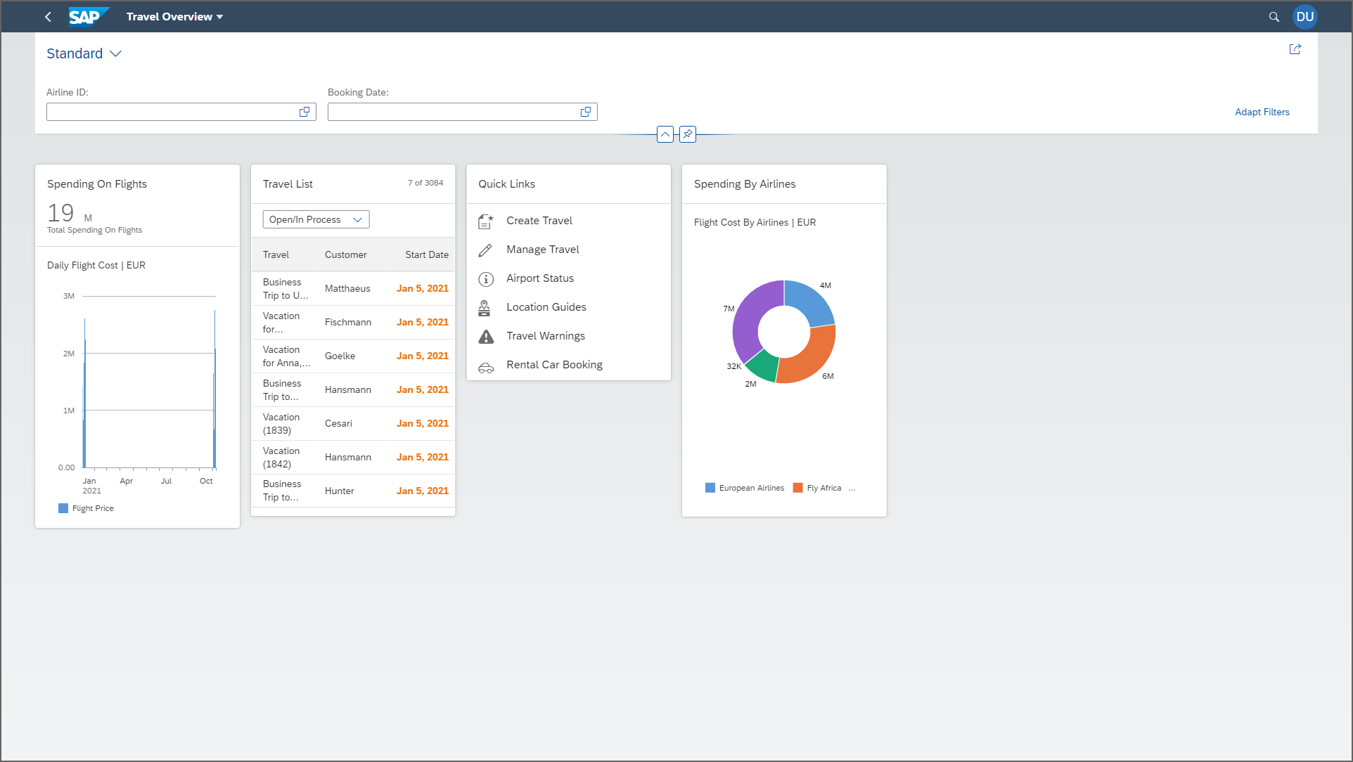

OVP
www.anubhavtrainings.com

Slide 7
Reference Scenario – Unmanaged Impl.
Imagine in our company we had written all the business logic in the past ourself in form of FM, Classes. Today we want to reuse our old code which has the business logic, validation, sequence, processing, along with transaction buffer. So if you want to manage all these codes yourself and integrate your legacy (old code written by you or your team), you will opt for unmanaged (here RAP is not managing the CURD operation) scenario.
SAP is providing a demo class for learning purpose viz. /dmo/cl_flight_legacy
In this class we have our own old logic which contains the transaction buffer and business logic to maintain all the source code to interact with database ourself.
The RAP framework allows us to implement the entire runtime of the BO
Interaction Phase (code to interact and keep data inside itab)
Transaction Buffer (like a internal table where we keep temporary data)
Save Sequence (Commit work and Rollback)
UPDATE_BAPI
(LUW)
BAPI_TR_COMMIT
BAPI_TR_ROLLBACK
www.anubhavtrainings.com

Slide 8
Development Flow
Serv Impl.
BIMP-unmanaged
Serv definition
BDEF - unmanaged
Travel_U
Travel_U_MDE
Agency
Customer
agency
customer
/dmo/travel
www.anubhavtrainings.com

Slide 9
Title
<>
How you know in the code which fields are changed on the screen by the user.
So accordingly we can update the data into the database only for the changed fields??
RAP provides a compiler structure called %control which will tell us what fields were changed on UI.
We need to tell the RAP, what will be the datatype for the control structure.
*
*
*
www.anubhavtrainings.com

Slide 10
www.anubhavtrainings.com
Thank You
End of Day 14
www.anubhavtrainings.com

Slide 11


We’re committed to empower you to be
#FutureReady
through powerful training solutions.
We build the workforce of the future.
250+
Corporate Clients
30,000+
Learners Trained
25000+
Learners Placed
FREE WEBINARS
Sign up for free webinars with industry experts every fortnight!
Enroll Now!
Contact us today!
https://anubhavtrainings.com

